Slide 1
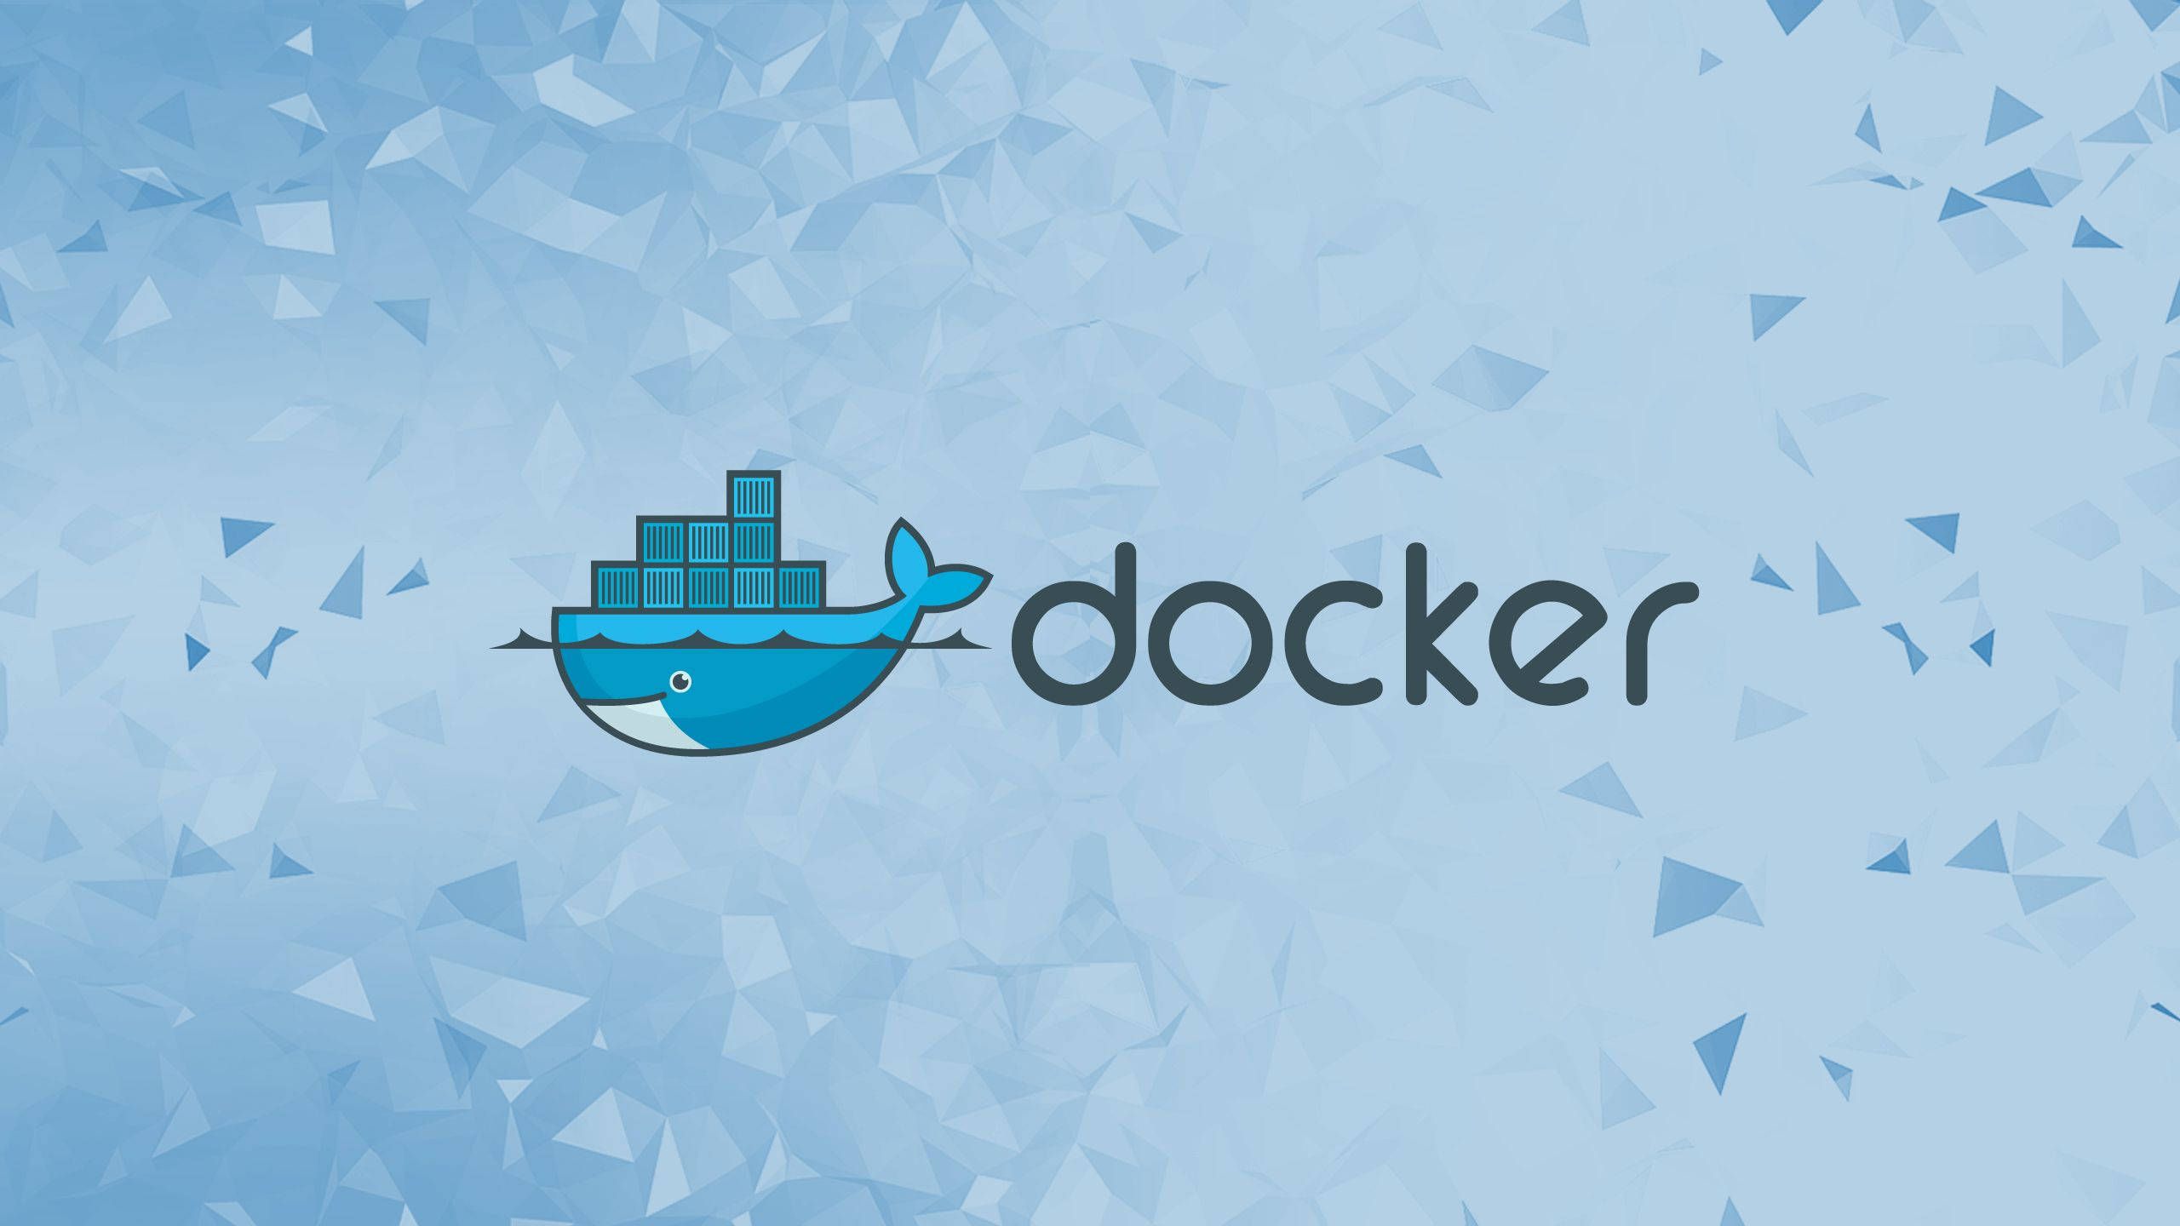
Docker Part I
Build, Ship, Run

Slide 2
What is Docker:
Docker is an open platform designed to simplify the process of developing, shipping, and running applications. It streamlines software delivery by using containerization.
At its core, Docker relies on several key concepts: the Docker Engine, Docker Hub, Images, Containers, Dockerfiles, and Docker Compose. Understanding all of these components enables you to create, deploy, and manage containerized applications.
You can use and interact with Docker using commands, but this platform also offers a desktop version with a graphical interface
When using the Docker ecosystem, various errors can occur on any layer, whether it’s on the image, Dockerfile, or the container itself. Since these problems can cause the whole containerization system to malfunction

Slide 3
What is Containerization:
Containerization is an operating-system-level virtualization that packages software applications to run in isolated user spaces called containers.
Containerization is a way of packaging software so that an application and everything it needs to run (libraries, configuration, dependencies) are bundled into a single isolated unit called a container that can run consistently on any infrastructure.
Instead of each application bringing its own full operating system, containers share the host OS kernel but stay isolated from one another, which makes them lightweight, fast to start, and easy to move between environments like laptops, servers, and clouds.
Containerization and virtualization with VMs both enable running multiple isolated environments on one host, but they differ fundamentally in architecture and efficiency. Containers share the host OS kernel while isolating processes, making them lightweight, whereas VMs emulate full hardware via a hypervisor, each running a complete guest OS.

Slide 4
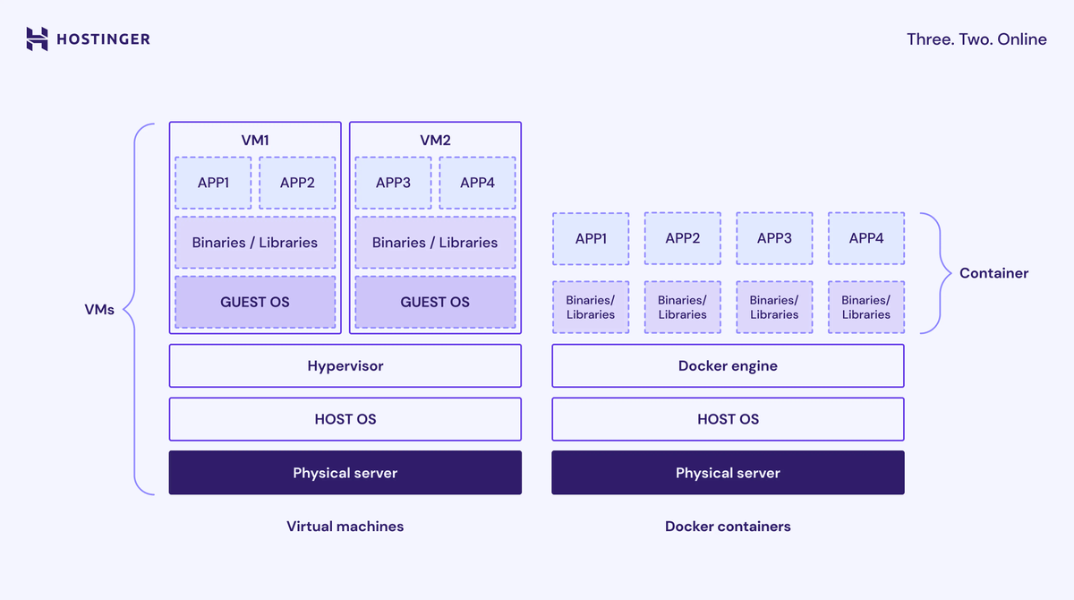
What is Containerization:

Slide 5
What is Containerization:
A container bundles an application with all its necessary components – code, system libraries, dependencies, and configuration files – to create an isolated environment.
Unlike Virtual Machines (VMs), containers are lightweight because they share the host system’s common operating system kernel. This independence from the underlying infrastructure enables applications to run consistently across different environments.
The benefits of containerization include:
Portability. Containers run consistently in any environment
Efficiency. While VMs require a full guest operating system and a hypervisor, containers don’t.
Isolation. Each container runs isolated processes, with its own software, configuration, network stack, and environment variables.

Slide 6
Why should I use Docker?
The “but it works on my machine” problem. Docker ensures that an application runs consistently for every developer and in every stage of production, thereby eliminating environment-related bugs.
Rapid development and deployment. It simplifies the process of creating a reproducible environment. Developers can integrate features like maps or payment gateways without having to build them from scratch, which saves time.
Scalability and portability. Using tools like Docker Compose, you can define a complex multi-container application stack in a single file and easily share it, ensuring consistency across teams and scaling services as needed.
Resource efficiency. Since containers are lightweight and share the host OS kernel, they require fewer resources than traditional VMs.

Slide 7
the core Docker concepts

Slide 8
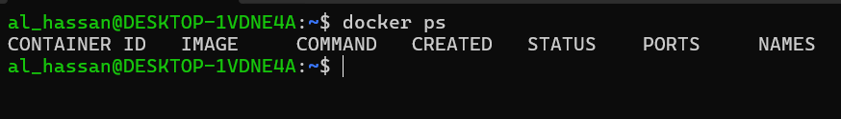
Docker Engine:
Docker Engine is the core open-source technology for building and containerizing your applications. It uses a client-server architecture to manage all Docker objects, like images.
The server. A long-running daemon process (dockerd) that handles all the important tasks, such as creating, running, and destroying containers.
APIs. Interfaces that allow programs, including Docker CLI, to communicate with and instruct the daemon.
The CLI client. The Docker command-line tool, which is the primary way for users to interact with the platform.
This command asks the Docker Daemon to list all currently running containers, when just installed you should see something like this.

Slide 9
Docker Hub:
Docker Hub is the default public Docker registry – a storage and distribution service for Docker images.
When you build a container, you need to install various software packages from images. Docker Hub simplifies the process by allowing you to download images from a centralized repository.
Docker Hub uses tags to label and identify images, which denote a specific version of the software package, such as latest.
You can interact with Docker Hub using the Docker command.

Slide 10
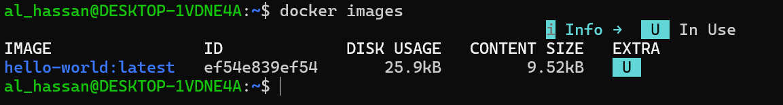
Docker Images:
A Docker image is a read-only template that contains all the instructions and files needed to create a Docker container. It packages the application code, configuration files, system libraries, and the base operating system files.
Images are built from a Dockerfile, where each instruction creates a distinct, immutable layer that defines what the image should contain or do.
To list the images you have locally downloaded, use:
To build an image from a Dockerfile in the current directory, run:
DON’T FORGET
If the base image referenced in the Dockerfile is not already on your machine, Docker automatically pulls it from Docker Hub. The best practice when using images is to use a minimal base image to reduce the size and minimize the potential attack surface commonly introduced by unnecessary packages or components.

Slide 11
Docker Containers:
A container is a runnable instance of an image. It is the isolated space where your application executes, along with its configuration, dependencies, and required software packages.
When you create a Docker container, a writable layer is added on top of the image’s read-only layers, allowing you to make file modifications in its local filesystem.
Containers are designed to be ephemeral or stateless, meaning they can be stopped, destroyed, rebuilt, and replaced with minimal configuration.
An individual container is managed with the Docker CLI, while multiple ones are administered using Docker Compose or an orchestration tool like Kubernetes.
To create a Docker container and run a command inside it, simply use the run command:

Slide 12
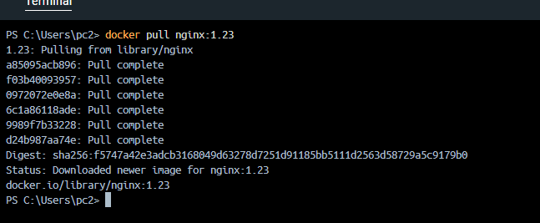


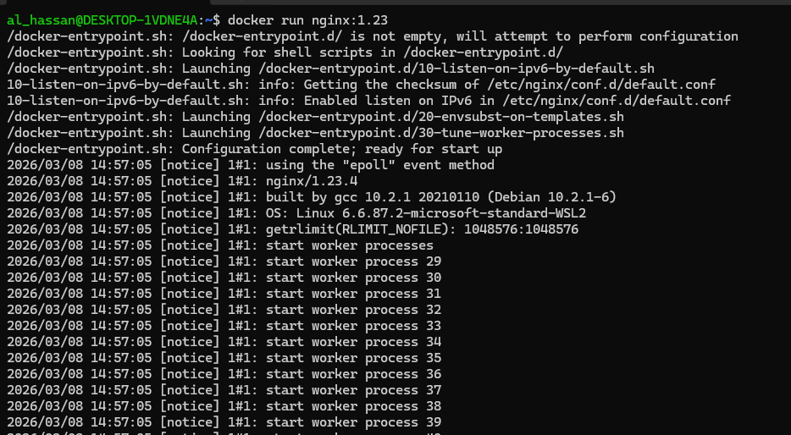
Running Docker Images:
1
2
3
The docker container is running but till now we can’t use it.
3

Slide 13
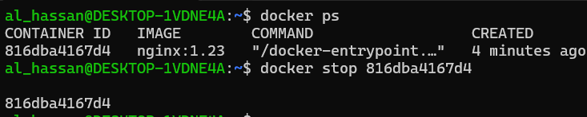
Port Binding:
Stop a running container
What is this?
App inside container runs in an isolated Docker Network. This allows us to run the same app running on the same port multiple times.
So, we need to expose the container port to the host (the machine the container runs on).

Slide 14
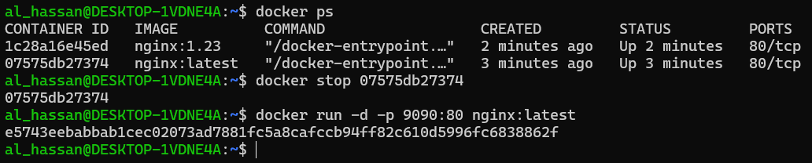
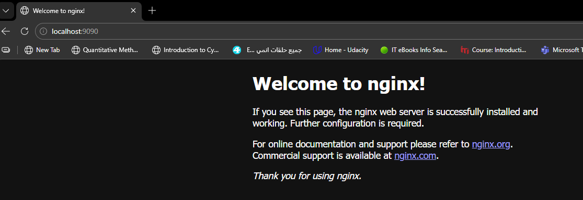
Port Binding:
Port Binding: Binds the container port to the host port to make the service available to the outside world

Slide 15
References:
https://docs.docker.com/
https://www.hostinger.com/tutorials/docker-tutorial
https://www.youtube.com/watch?v=pg19Z8LL06w&t=1s
Section Record:
https://drive.google.com/file/d/1bXiIvs29lPrt4hX37Lfk8PueLlXD2_A6/view?usp=sharing

Slide 16
THANK YOU

